Slide 1
Credit Risk Prediction
25 September 2020

Slide 2
Classifiers
Background
One popular use of machine learning is the prediction of credit risks in issuing housing loans. This was a major concern during the Lehman crisis , when the default of several subprime mortgages causes the eventual collapse of collateral loan. The bank has collected past data on customers’ default behaviour and their characteristics in the data set HMEQ – home equity.
Problem Statement
What is the chance that the customers will default ?
Approach
Data Science Process

Slide 3
Dataset - HMEQ
The data set HMEQ reports characteristics and delinquency information for 5,960 home equity loans. A home equity loan is a loan where the obligor uses the equity of his or her home as the underlying collateral. The data set has the following characteristics:
◾ BAD: 1 = applicant defaulted on loan or seriously delinquent; 0 = applicant paid loan
◾ LOAN: Amount of the loan request
◾ MORTDUE: Amount due on existing mortgage
◾ VALUE: Value of current property
◾ REASON: DebtCon = debt consolidation; HomeImp = home improvement
◾ JOB: Occupational categories
◾ YOJ: Years at present job
◾ DEROG: Number of major derogatory reports
◾ DELINQ: Number of delinquent credit lines
◾ CLAGE: Age of oldest credit line in months
◾ NINQ: Number of recent credit inquiries
◾ CLNO: Number of credit lines
◾ DEBTINC: Debt-to-income ratio
Original source : https://archive.ics.uci.edu/ml/datasets/bank+marketing

Slide 4
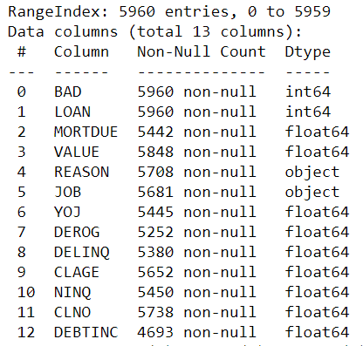
Exploratory Data Analysis
Cleaning data
Handful of null values and missing values.

Slide 5
EDA – Cleaning Data
Features | Approach for missing info
Observations #3 and #1405 | Deletes as they have null values across features apart from target-BAD and feature-LOAN
REASON | Left as “unknown” as there is insufficient information to replace with appropriate values.
JOB | ‘Nil’ if YOJ is NaN ‘Other’ if YOJ is not NaN
YOJ | 0 if JOB is NaN 1 if JOB is not NaN
MORTDUE | 0 if MORTDUE is NaN and VALUE is NaN 0 if MORTDUE is NaN and VALUE is not-NaN as property owner may not need to take up mortgage
VALUE | 0 if MORTDUE is NaN and VALUE is NaN Equivalent to MORTDUE if MORTDUE is not-NaN
DEROG | 0 for non-default 1 for default
DELINQ | 0 for non-default 1 for default
CLAGE | Mean of CLAGE of non-default for BAD of 0 Mean of CLAGE of default for BAD of 1
NINQ | 0 for null values
CLNO | Mode of CLNO of non-default for BAD of 0 Mode of CLNO of default for BAD of 1
DEBTINC | Mean of DEBTINC based on BAD, REASON, JOB

Slide 6
Exploratory Data Analysis
Imbalanced dataset
No. of Non-Defaults = 4771
No. of Defaults = 1189
Did not apply Imblearn, SMOTE to rebalance the dataset due to time constraints

Slide 7
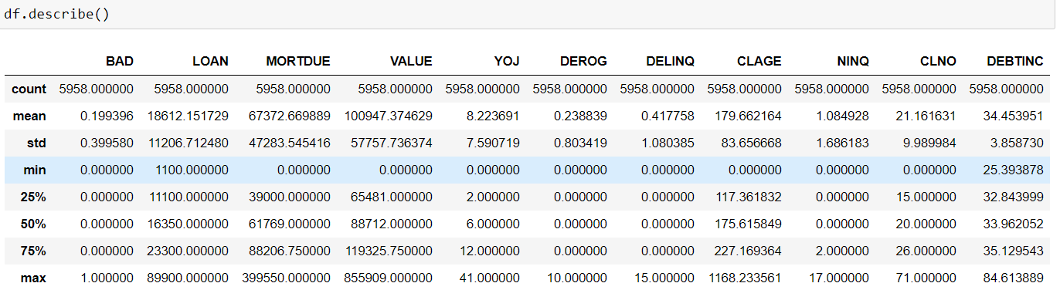
EDA – Analysis of cleaned data

Slide 8
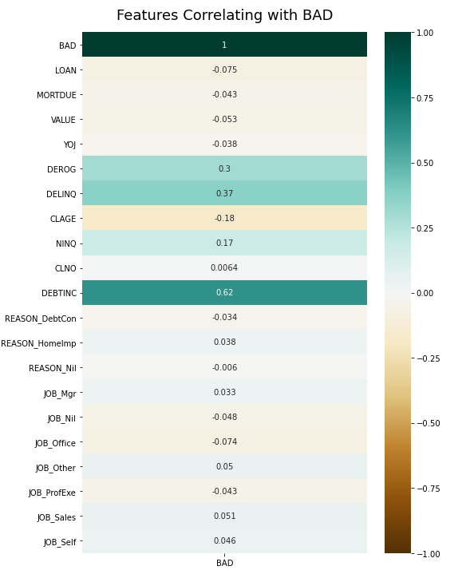
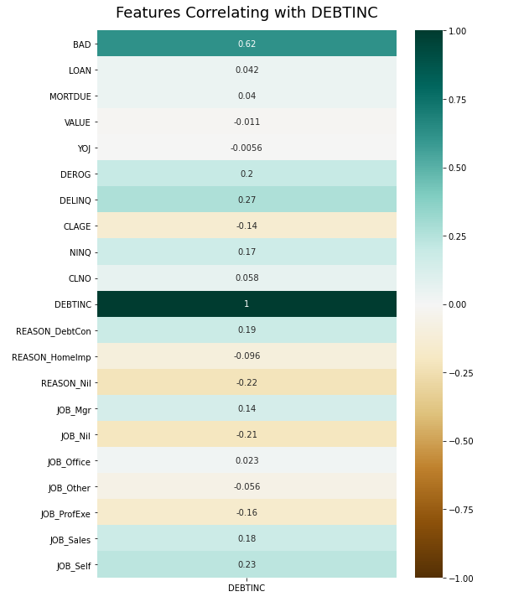
EDA – Correlations

Slide 9
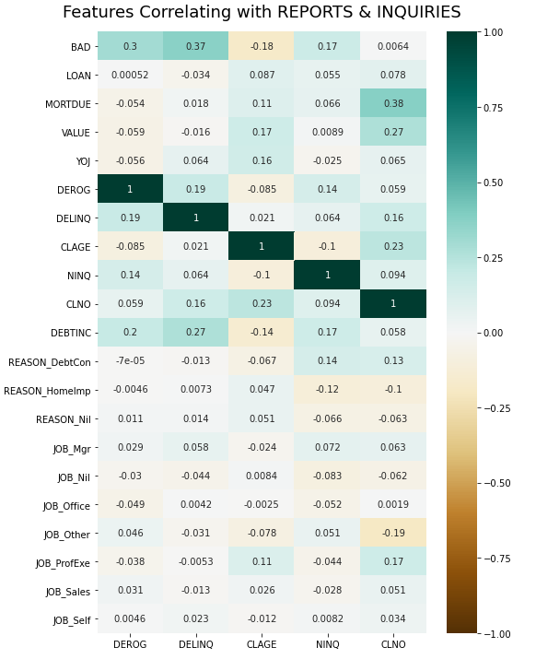
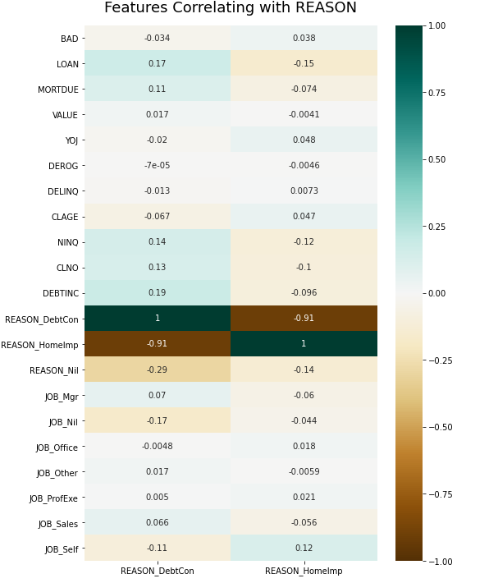
EDA – Correlations

Slide 10
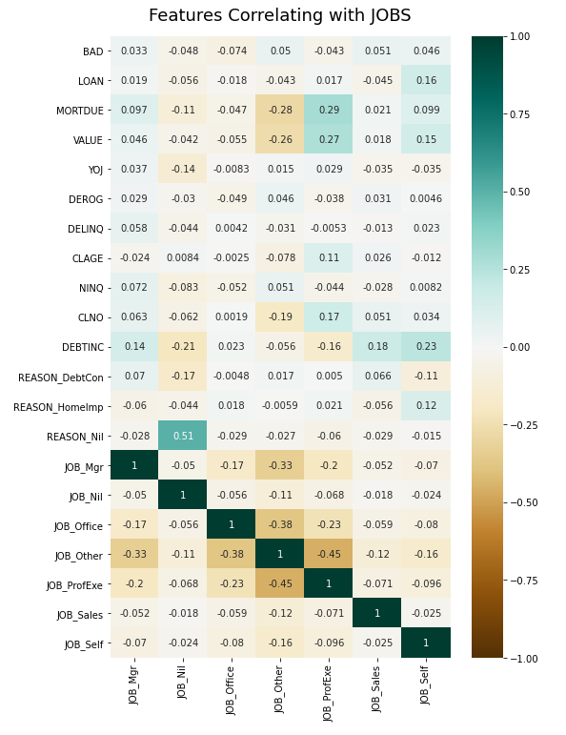
EDA – Correlations - JOBS

Slide 11
FEATURES SELECTION
Features Selected
Feature 0 - 'DEROG’
Feature 1 - 'DELINQ’
Feature 2 - 'DEBTINC’
Feature 3 - 'REASON_DebtCon’
Feature 4 - 'YOJ’
Feature 5 - 'VALUE’
Feature 6 - 'CLNO’
Features Preprocessing – Standard Scaler

Slide 12
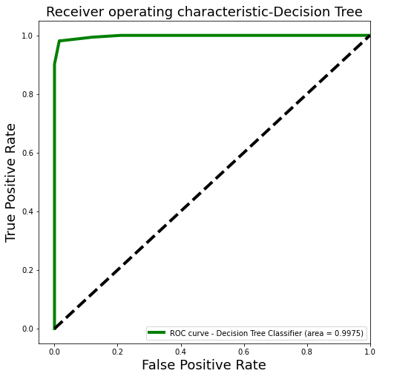
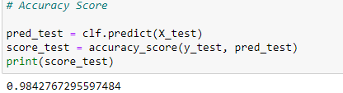

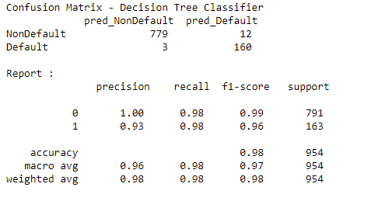
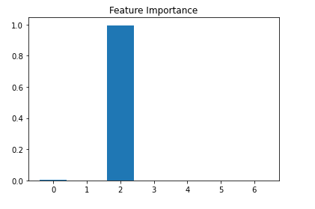
Model & Validate - #1 Decision Tree

Slide 13
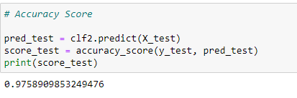
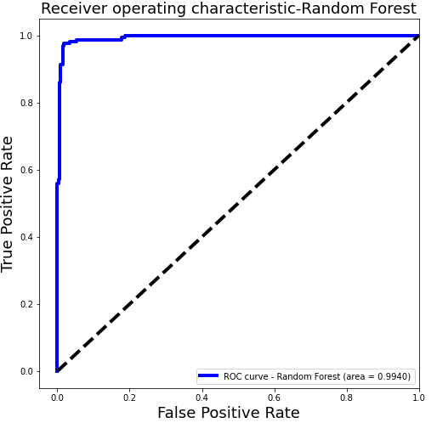

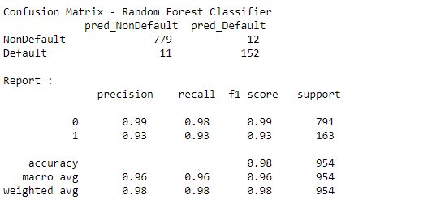
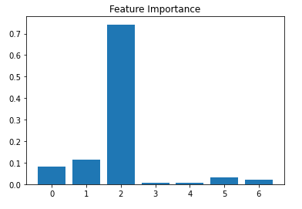
Model & Validate - #2 Random Forest

Slide 14
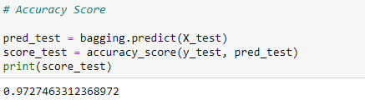
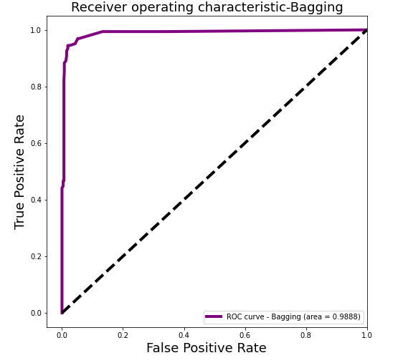

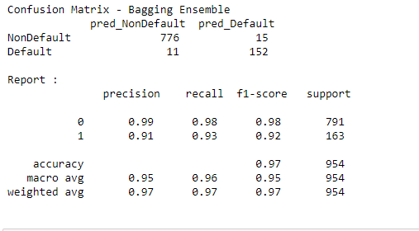
Model & Validate - #3 Bagging Ensemble

Slide 15
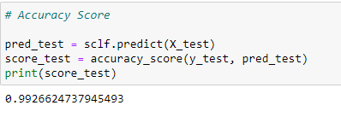
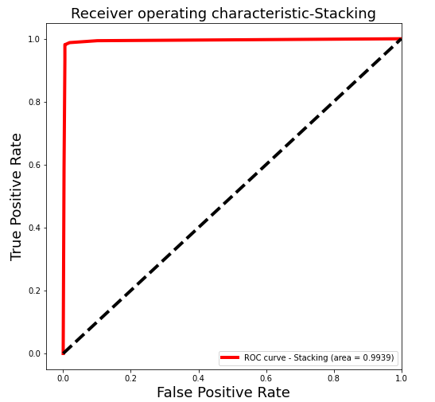

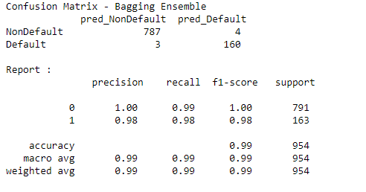
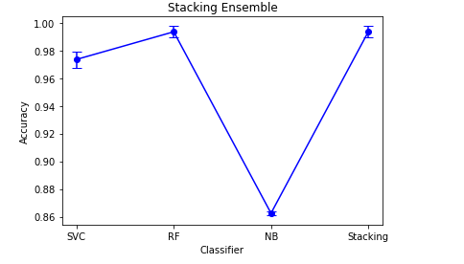
Model & Validate - #4 Stacking Ensemble

Slide 16
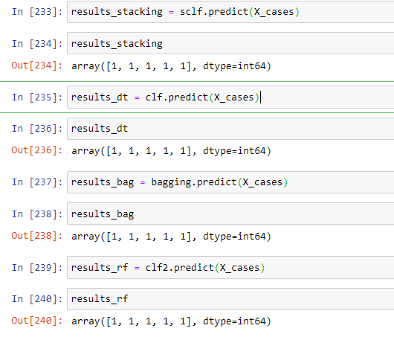
Predictions
Cleaned customer 2
'DEROG’ assigned to 0
'DEROG’ assigned to 0
‘MORTDUE’ assigned to 0
Run the customers through the 4 models

Slide 18
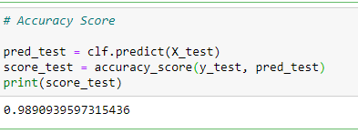
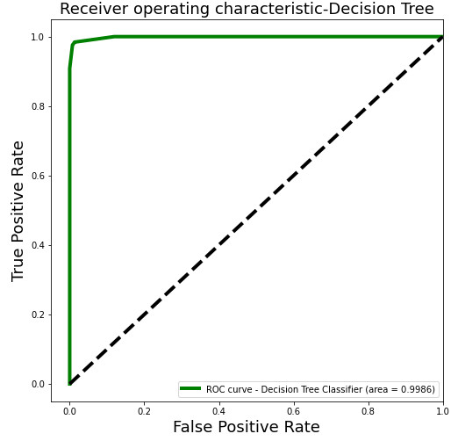

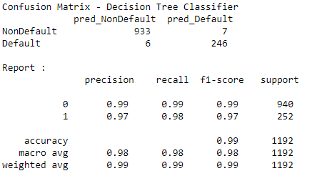
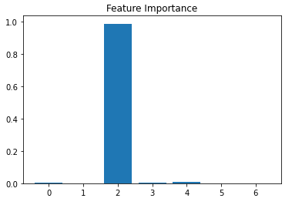
Model & Validate - #1 Decision Tree

Slide 19

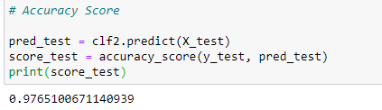

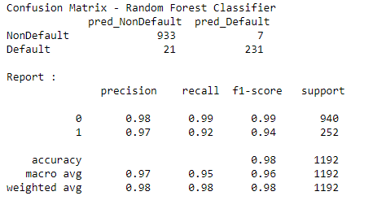
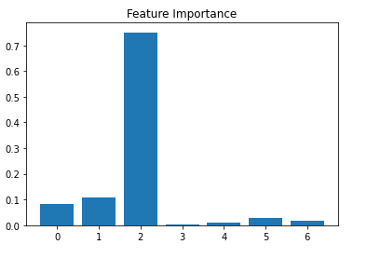
Model & Validate - #2 Random Forest

Slide 20
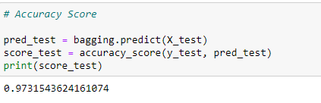
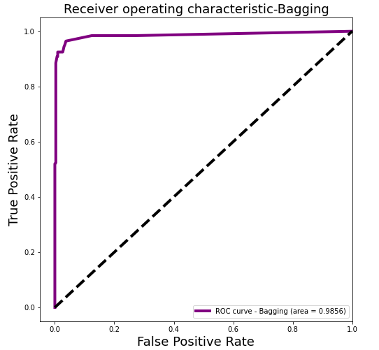
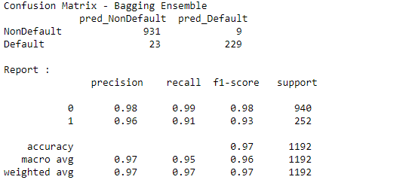
Model & Validate - #3 Bagging Ensemble

Slide 21
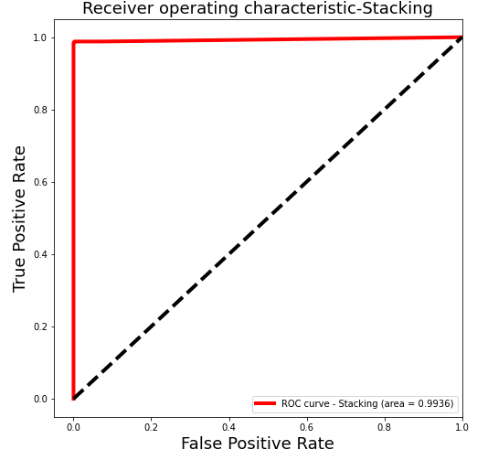
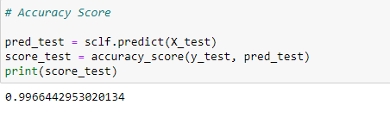

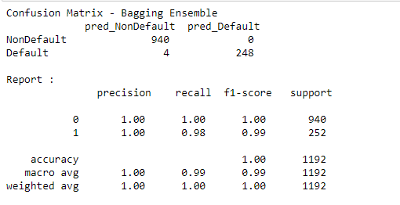
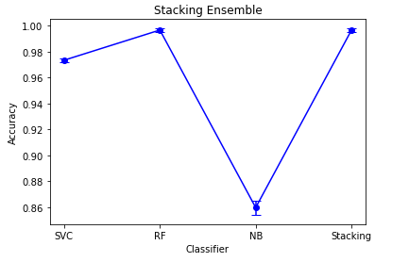
Model & Validate - #4 Stacking Ensemble

